Slide 1
Knowledge Management – Part 3
Bob Marshall, MD MPH MISM FAAFP Program Director, DoD/MAMC Clinical Informatics Fellowship

Slide 2
Agenda/Objectives

Slide 3
Taking a Fresh Look at KM
The digital workplace is changing how intellectual assets are delivered to the enterprise, transforming how employees work with each other and the way in which knowledge is generated and shared
All of this disruption leaves IT leaders asking, does knowledge management still matter?

Slide 4
Increasing Reliance on Nonroutine Work
Successful businesses increasingly depend on nonroutine and digital work that relies on decision making, creativity, leadership and innovation
In this context, the ability to create, capture, diffuse and utilize all available information assets that include know-how, best practices and specialist expertise can raise effectiveness and competitiveness

Slide 5
Important changes in the nature of employee demographics work and advances in technology enablement are projecting KM back onto center stage
However, because of its patchy reputation since its heyday in the 1990s, there is still a justifiable fear of failure that is keeping IT leaders away
from KM initiatives.
Despite its track record, KM continues to be an important discipline that can deliver value by promoting an integrated approach to leveraging an enterprise's explicit and tacit intellectual assets.
In addition, some important business and technology drivers are boosting both its business relevance, and its chances of success
Notes:
When it was first implemented, it was complicated and unwieldy, often poorly implemented, and as such developed a poor reputation as ineffective and expensive. However, technologies have improved dramatically that make KM easier. Ex: software that not only tracks and records facial expressions, but interprets it as well.

Slide 6
Specific technology advances are helping to create new opportunities for KM objectives that were previously not practical
Virtual social environments that focus primarily on conversations make it easier to capture, organize and share information
This can help to achieve KM objectives indirectly as a byproduct of individuals, teams, communities and networks performing their work in these shared environments

Slide 7
Those social workplace environments embedded in business applications, or that align well with individual work requirements (such as file sync and share, or browser-based office suites) increase the likelihood of the capture and reuse of relevant information.
This is despite such environments not being designed primarily to support KM
In short, the creation, capture and reuse of relevant knowledge are now intrinsic to the work activity, rather than requiring separate actions

Slide 8
KM programs that focus purely on collecting, storing and accessing documents or other static artifacts are missing an essential ingredient and would be better approached as a document management or general information management program
KM programs need to focus on people and the knowledge in motion, as well as the socialization processes through which knowledge artifacts get created, transferred and used
The collection and storage of static documents alone is inadequate

Slide 9
Being clear about the scope, context and objectives is particularly important with KM because it can be pursued both as a comprehensive enterprise-wide program and as a more specific effort to improve areas of business activity
Top-down initiatives and high-level commitments need to be converted into specific efforts that support practical, pragmatic business issues, and which deliver early value, both to the organization and to individuals that participate

Slide 10
Visibility within the organization should flow from the top down, starting with senior executive validation
Initial efforts should concentrate mostly on achieving demonstrable value from specific projects and applications
Once established, attention should be placed on common guidelines, leanings and platforms that can improve efficiency

Slide 11
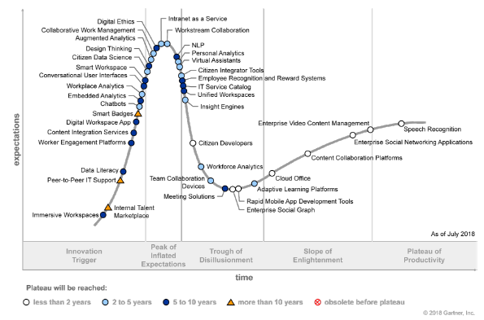

Slide 12
Impacts
IT leaders continue to seek content-focused technology solutions, leaving critical people and contextual aspects of knowledge management unsupported
Emerging technologies associated with the digital workplace are creating opportunities to advance the people, collaboration and contextual aspects of knowledge management, causing IT leaders to rethink technology-focused strategies

Slide 13
Gartner Recommendations
Revisit existing knowledge management from the point of view of the business, identifying guiding principles for operational and technological planning
Focus on finding technologies that support knowledge management practices and not on trying to fit knowledge management into specific technologies
Treat knowledge management as a critical enterprise practice that is enabled by digital workplace strategies and associated technologies

Slide 14
Analysis
The challenging part of knowledge management is going beyond information and into knowledge
Knowledge management, when put into practice, lies at the intersection of four elements; people, collaboration, content and context
The interplay of these elements, especially the non-content-related aspects of knowledge management — people, collaboration and context — align with key capabilities that the digital workplace is designed to help the business achieve

Slide 15
Analysis
The digital workplace represents a double-edged sword for knowledge management:
On one edge, emerging technologies associated with the digital workplace are transforming the nature of work, adding complexity to employee engagement and how intellectual assets are created, curated and used
On the other edge, digital workplace strategies expand how enterprise information is used, providing context to how employees work with information and each other

Slide 16
Analysis
Digital-workplace-related technologies support knowledge management activities by enabling:
Individual and team agility through more choice in devices and apps, and a focus on easy-to-use analytics
Consumer-like experiences that augment routine work through automation and services that promote contextual interfaces
New ways for recognizing employee contributions through a content and collaboration infrastructure that is more open and more social
People-centric approaches to security and identity and access management which make it easier to get to information resources

Slide 17
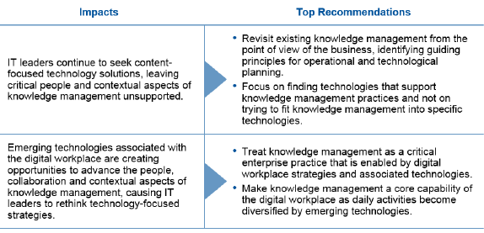
Impacts and Top Recommendations

Slide 18
Measuring Knowledge Management

